Slide 1
Designing Your Data: The bread and butter of APL
Aaron W. Hsu aaron@dyalog.com, Dyalog, Ltd.
Functional Conf 2025, Inside the Matrix

Slide 2
───􀓥───􀓢───􀓢───􀓢───􀓢───􀓢───􀓢───􀓢───􀓢───􀓢───􀓢───􀓢───􀓢───􀓢───􀓢───􀓢──
Background
APL

Slide 3
───􀓥───􀓢───􀓢───􀓢───􀓢───􀓢───􀓢───􀓢───􀓢───􀓢───􀓢───􀓢───􀓢───􀓢───􀓢───􀓢──
Background
APL
The language with all those funny symbols.

Slide 4
───􀓥───􀓢───􀓢───􀓢───􀓢───􀓢───􀓢───􀓢───􀓢───􀓢───􀓢───􀓢───􀓢───􀓢───􀓢───􀓢──
Background
APL
(2=+⌿0=X∘.|X)⌿X←1+⍳N ⍝ Prime Numbers up to N
⊃1 ⍵∨.∧3 4=+⌿,¯1 0 1∘.⌽¯1 0 1⊖¨⊂⍵ ⍝ Game of Life
0⌈(,[2+⍳3]{⍵}⌺3 3⊢⍵)+.×,[⍳3]⍺ ⍝ RelU, 3×3 Convolution

Slide 5
───􀓥───􀓢───􀓢───􀓢───􀓢───􀓢───􀓢───􀓢───􀓢───􀓢───􀓢───􀓢───􀓢───􀓢───􀓢───􀓢──
Background
APL is:

Slide 6
───􀓥───􀓢───􀓢───􀓢───􀓢───􀓢───􀓢───􀓢───􀓢───􀓢───􀓢───􀓢───􀓢───􀓢───􀓢───􀓢──
Background
APL is:
A rich, economical vocabulary over arrays…

Slide 7
───􀓥───􀓢───􀓢───􀓢───􀓢───􀓢───􀓢───􀓢───􀓢───􀓢───􀓢───􀓢───􀓢───􀓢───􀓢───􀓢──
Background
APL is:
A rich, economical vocabulary over arrays…
with a killer syntax.

Slide 8
───􀓢───􀓥───􀓢───􀓢───􀓢───􀓢───􀓢───􀓢───􀓢───􀓢───􀓢───􀓢───􀓢───􀓢───􀓢───􀓢──
Challenge
Beginners focus on the symbols (the “verbs”).

Slide 9
───􀓢───􀓥───􀓢───􀓢───􀓢───􀓢───􀓢───􀓢───􀓢───􀓢───􀓢───􀓢───􀓢───􀓢───􀓢───􀓢──
Challenge
Beginners focus on the symbols (the “verbs”).
They get stuck when the problem “doesn’t fit” arrays.

Slide 10
───􀓢───􀓥───􀓢───􀓢───􀓢───􀓢───􀓢───􀓢───􀓢───􀓢───􀓢───􀓢───􀓢───􀓢───􀓢───􀓢──
Challenge
Experts focus on the data.

Slide 11
───􀓢───􀓥───􀓢───􀓢───􀓢───􀓢───􀓢───􀓢───􀓢───􀓢───􀓢───􀓢───􀓢───􀓢───􀓢───􀓢──
Challenge
Experts focus on the data.
Encode the data for simplicity and efficiency
using the Array Model.

Slide 12
───􀓢───􀓥───􀓢───􀓢───􀓢───􀓢───􀓢───􀓢───􀓢───􀓢───􀓢───􀓢───􀓢───􀓢───􀓢───􀓢──
Challenge
How do they do it?
What are some tactics for data encoding in APL?

Slide 13
───􀓢───􀓢───􀓥───􀓢───􀓢───􀓢───􀓢───􀓢───􀓢───􀓢───􀓢───􀓢───􀓢───􀓢───􀓢───􀓢──
Foundations
The Relational Model

Slide 14
───􀓢───􀓢───􀓥───􀓢───􀓢───􀓢───􀓢───􀓢───􀓢───􀓢───􀓢───􀓢───􀓢───􀓢───􀓢───􀓢──
Foundations
The Relational Model
Tuples organized into Tables with Fields and a Header;

Slide 15
───􀓢───􀓢───􀓥───􀓢───􀓢───􀓢───􀓢───􀓢───􀓢───􀓢───􀓢───􀓢───􀓢───􀓢───􀓢───􀓢──
Foundations
The Relational Model
Tuples organized into Tables with Fields and a Header;
a language for manipulating relations.
Relational Variables correspond to named Tables.

Slide 16
───􀓢───􀓢───􀓥───􀓢───􀓢───􀓢───􀓢───􀓢───􀓢───􀓢───􀓢───􀓢───􀓢───􀓢───􀓢───􀓢──
Foundations
The Relational Model
Tuples organized into Tables with Fields and a Header;
a language for manipulating relations.
Relational Variables correspond to named Tables.
APL is an excellent extended relational algebra.

Slide 17
───􀓢───􀓢───􀓥───􀓢───􀓢───􀓢───􀓢───􀓢───􀓢───􀓢───􀓢───􀓢───􀓢───􀓢───􀓢───􀓢──
Foundations
The Array Model

Slide 18
───􀓢───􀓢───􀓥───􀓢───􀓢───􀓢───􀓢───􀓢───􀓢───􀓢───􀓢───􀓢───􀓢───􀓢───􀓢───􀓢──
Foundations
𝙰: Array
───────────────────────────
Elements: e₀ e₁ … eₙ₋₁ ∊ 𝙰 ,A
Shape: d₀ … dₖ₋₁ ∊ ℕ ⍴A

Slide 19
───􀓢───􀓢───􀓥───􀓢───􀓢───􀓢───􀓢───􀓢───􀓢───􀓢───􀓢───􀓢───􀓢───􀓢───􀓢───􀓢──
Foundations
𝙰: Array
───────────────────────────
Elements: e₀ e₁ … eₙ₋₁ ∊ 𝙰 ,A │ n ⟷ ≢,A Count
Shape: d₀ … dₖ₋₁ ∊ ℕ ⍴A │ k ⟷ ≢⍴A Rank
d₀ ⟷ ≢A Tally

Slide 20
───􀓢───􀓢───􀓥───􀓢───􀓢───􀓢───􀓢───􀓢───􀓢───􀓢───􀓢───􀓢───􀓢───􀓢───􀓢───􀓢──
Foundations
𝙰: Array
───────────────────────────
Elements: e₀ e₁ … eₙ₋₁ ∊ 𝙰 ,A │ n ⟷ ≢,A Count
Shape: d₀ … dₖ₋₁ ∊ ℕ ⍴A │ k ⟷ ≢⍴A Rank
d₀ ⟷ ≢A Tally
≡ Y Nesting level of A

Slide 21
───􀓢───􀓢───􀓥───􀓢───􀓢───􀓢───􀓢───􀓢───􀓢───􀓢───􀓢───􀓢───􀓢───􀓢───􀓢───􀓢──
Foundations
𝙰: Array
───────────────────────────
Elements: e₀ e₁ … eₙ₋₁ ∊ 𝙰 ,A │ n ⟷ ≢,A Count
Shape: d₀ … dₖ₋₁ ∊ ℕ ⍴A │ k ⟷ ≢⍴A Rank
d₀ ⟷ ≢A Tally
≡ Y Nesting level of A
struct array {
int rank;
int shape[rank];
struct array elements[n];
};

Slide 22
───􀓢───􀓢───􀓢───􀓥───􀓢───􀓢───􀓢───􀓢───􀓢───􀓢───􀓢───􀓢───􀓢───􀓢───􀓢───􀓢──
Slicing
Choice #1: Leverage inherent dimensionality

Slide 23

───􀓢───􀓢───􀓢───􀓥───􀓢───􀓢───􀓢───􀓢───􀓢───􀓢───􀓢───􀓢───􀓢───􀓢───􀓢───􀓢──
Slicing
Choice #1: Leverage inherent dimensionality

Slide 24
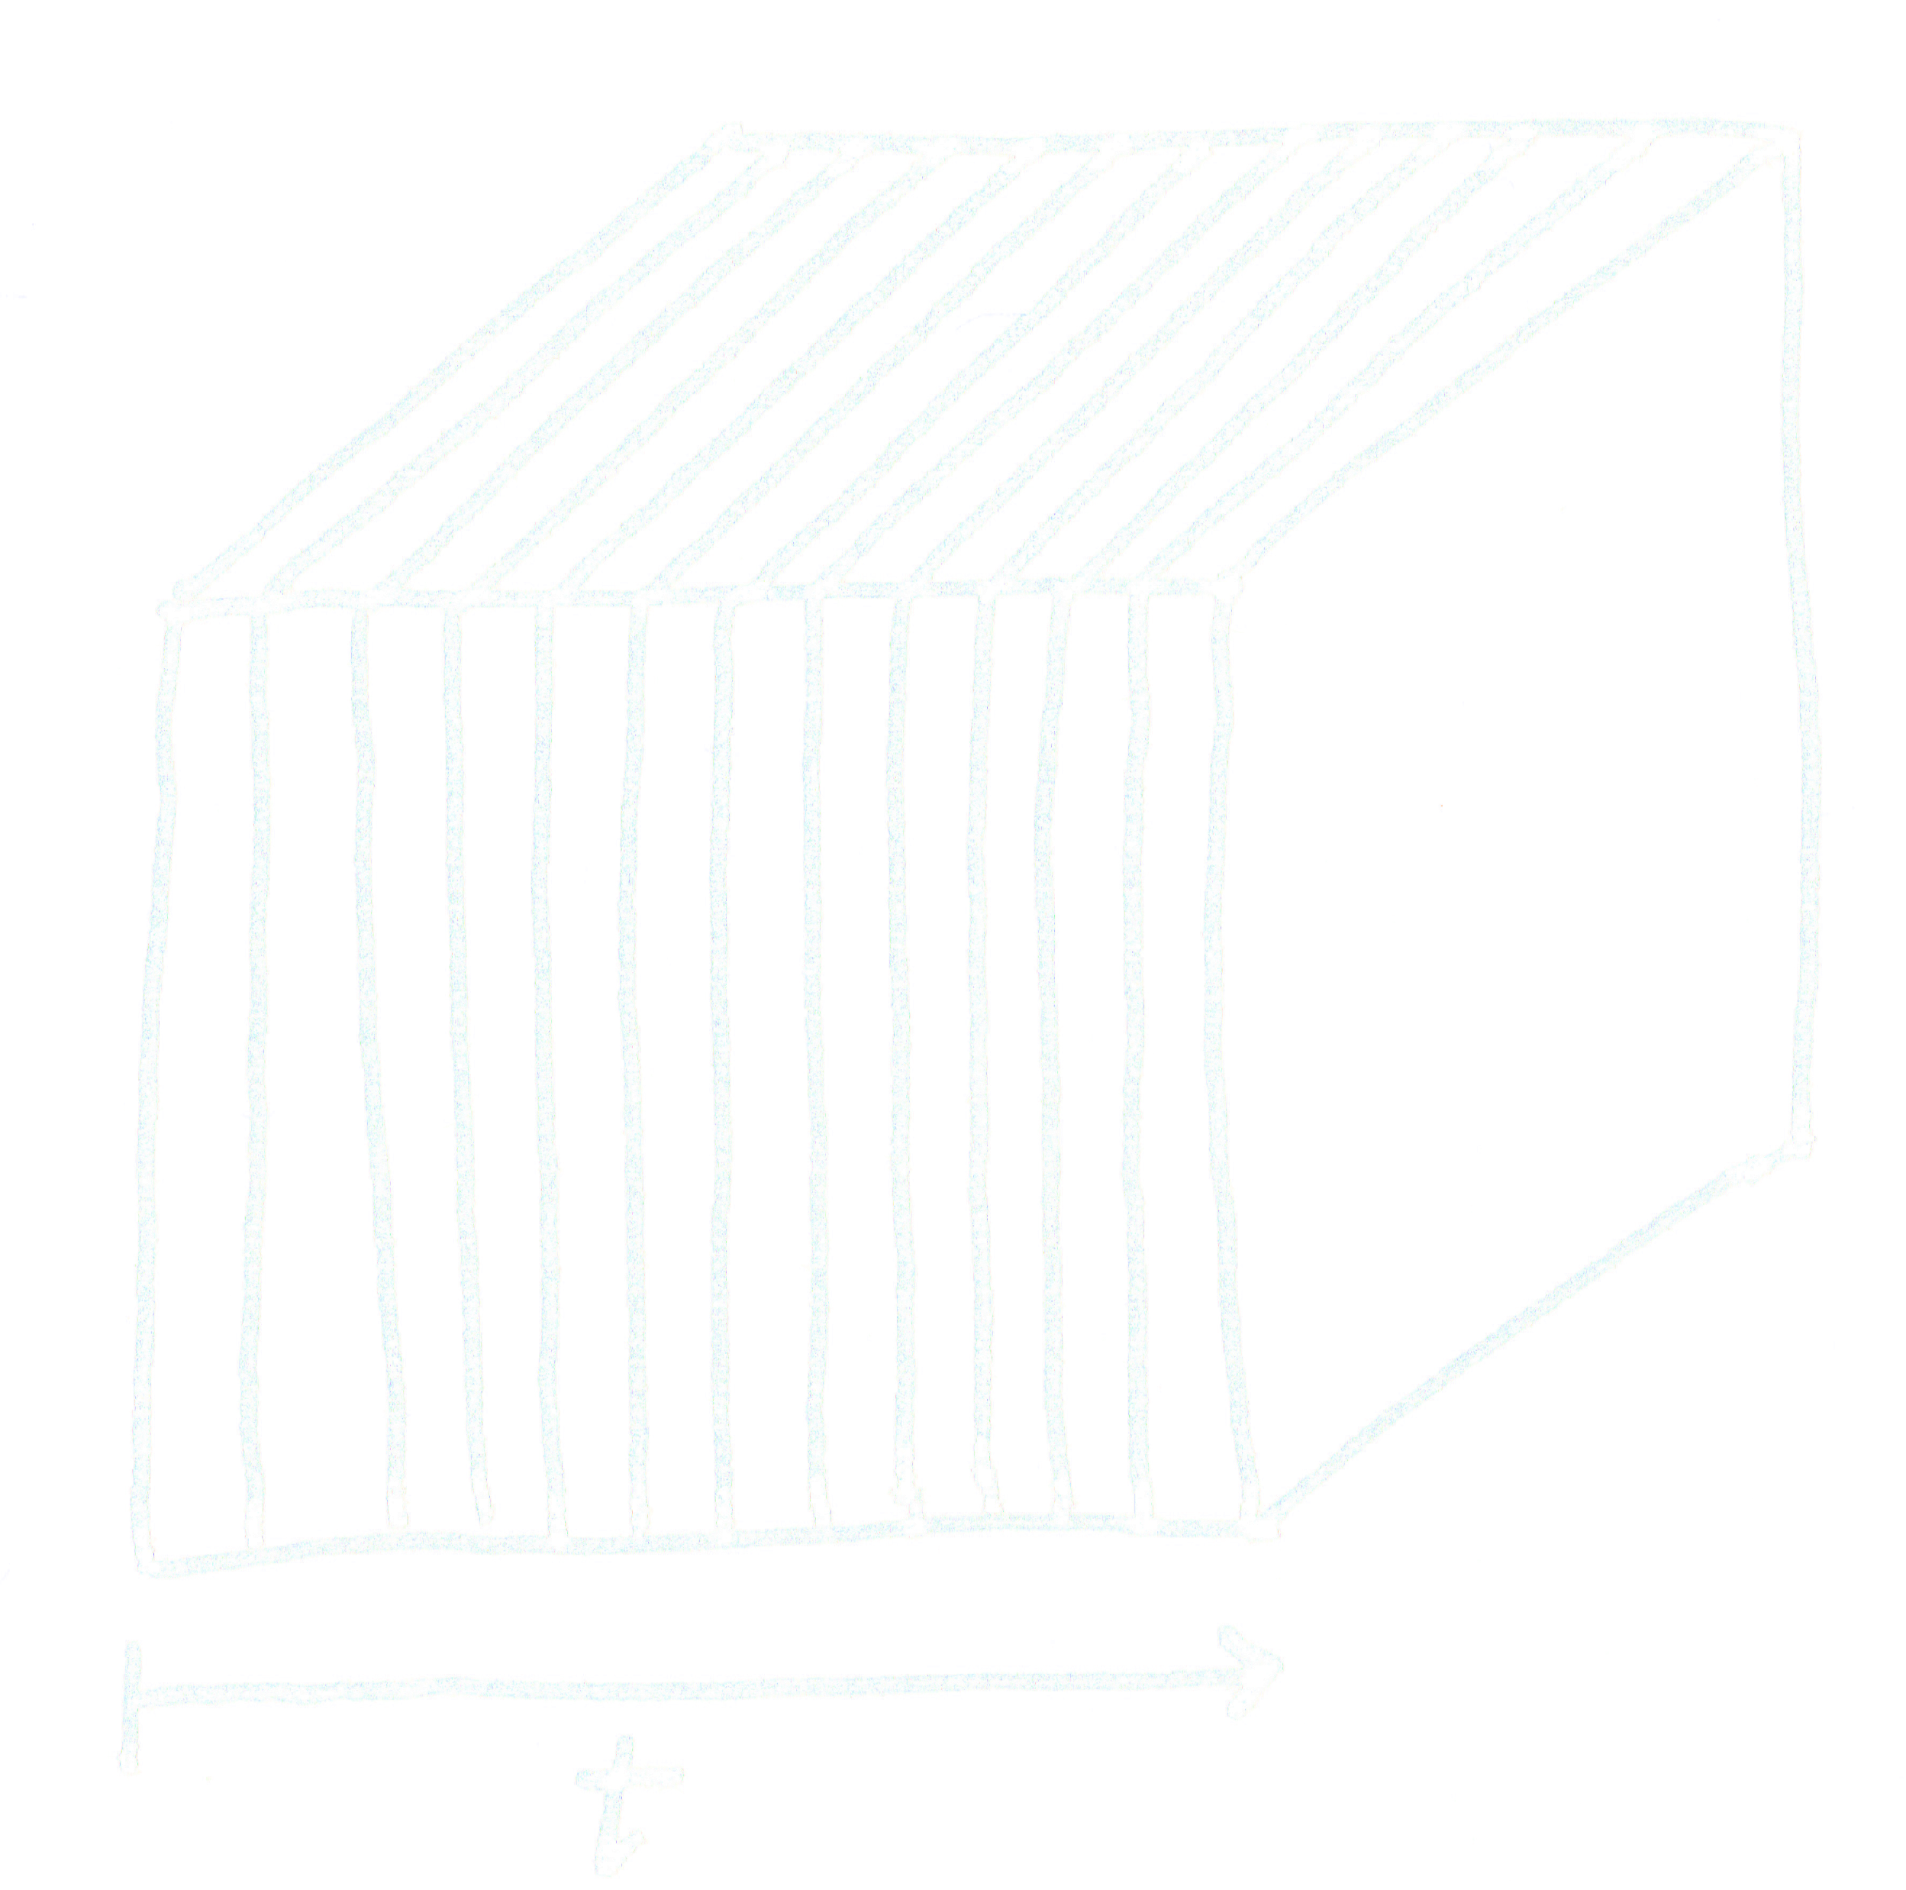


───􀓢───􀓢───􀓢───􀓥───􀓢───􀓢───􀓢───􀓢───􀓢───􀓢───􀓢───􀓢───􀓢───􀓢───􀓢───􀓢──
Slicing
Choice #1: Leverage inherent dimensionality

Slide 25
───􀓢───􀓢───􀓢───􀓢───􀓥───􀓢───􀓢───􀓢───􀓢───􀓢───􀓢───􀓢───􀓢───􀓢───􀓢───􀓢──
Aggregation
Aggregate objects instead of reified object references.

Slide 26
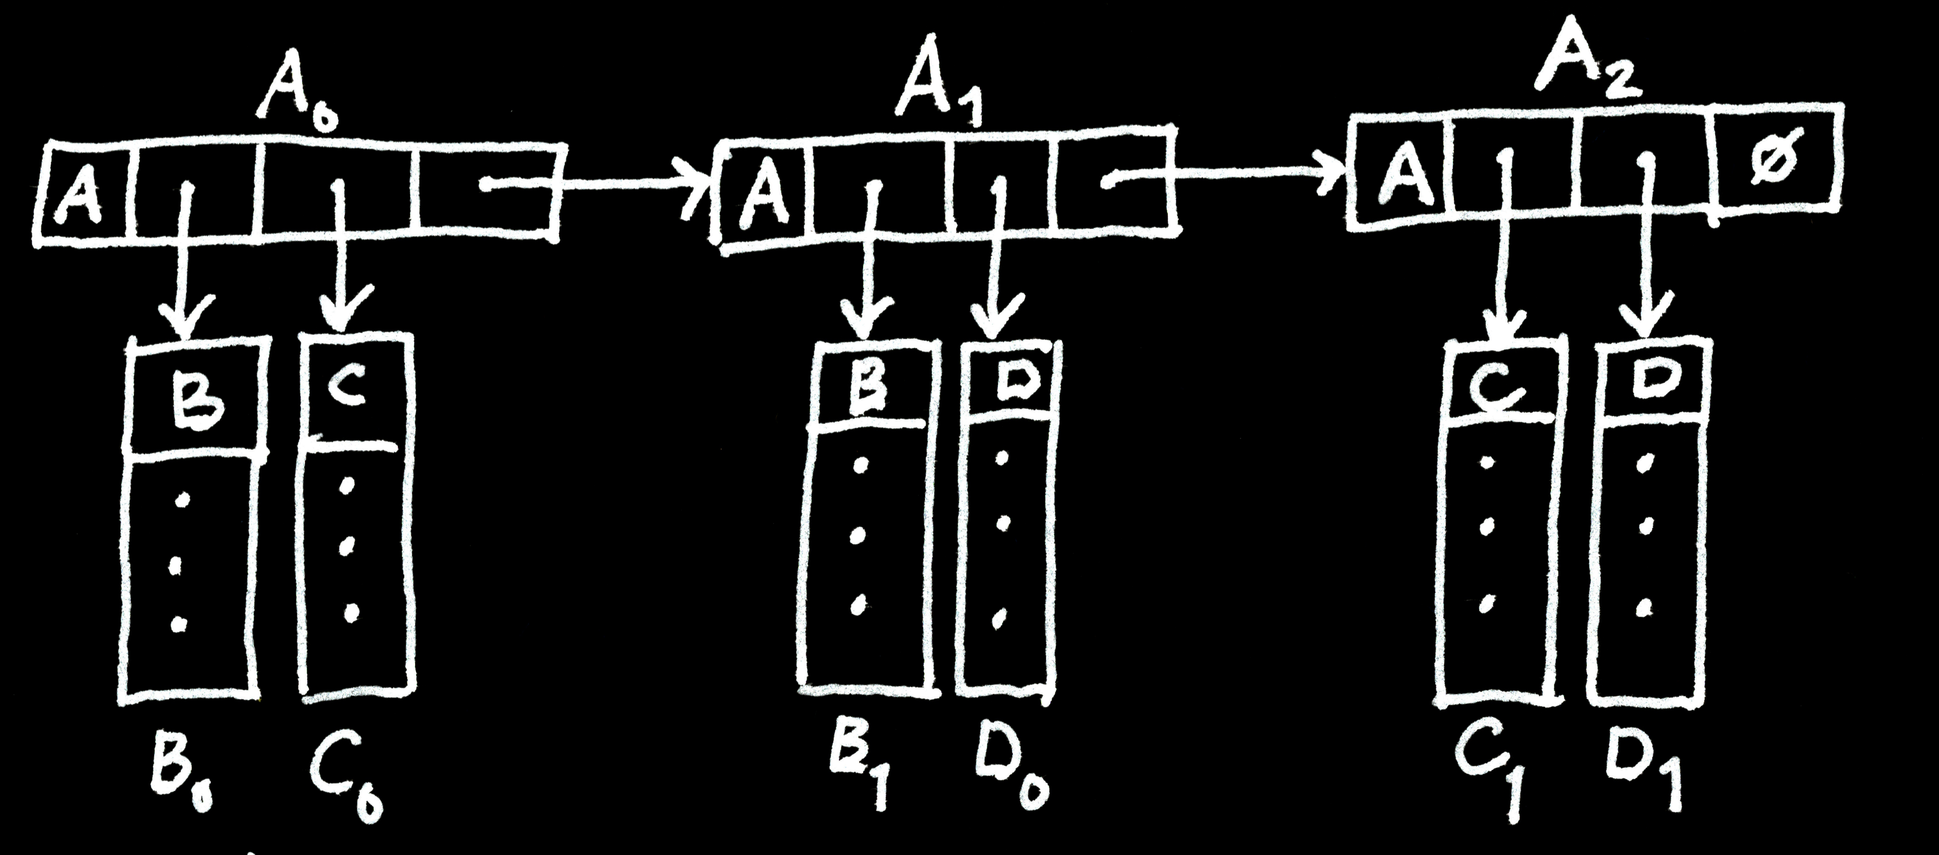
───􀓢───􀓢───􀓢───􀓢───􀓥───􀓢───􀓢───􀓢───􀓢───􀓢───􀓢───􀓢───􀓢───􀓢───􀓢───􀓢──
Aggregation
Aggregate objects instead of reified object references.

Slide 27

───􀓢───􀓢───􀓢───􀓢───􀓥───􀓢───􀓢───􀓢───􀓢───􀓢───􀓢───􀓢───􀓢───􀓢───􀓢───􀓢──
Aggregation
Aggregate objects instead of reified object references.

Slide 28
───􀓢───􀓢───􀓢───􀓢───􀓢───􀓥───􀓢───􀓢───􀓢───􀓢───􀓢───􀓢───􀓢───􀓢───􀓢───􀓢──
Inverted Tables
Use inverted tables to represent relations, complex objects.

Slide 29
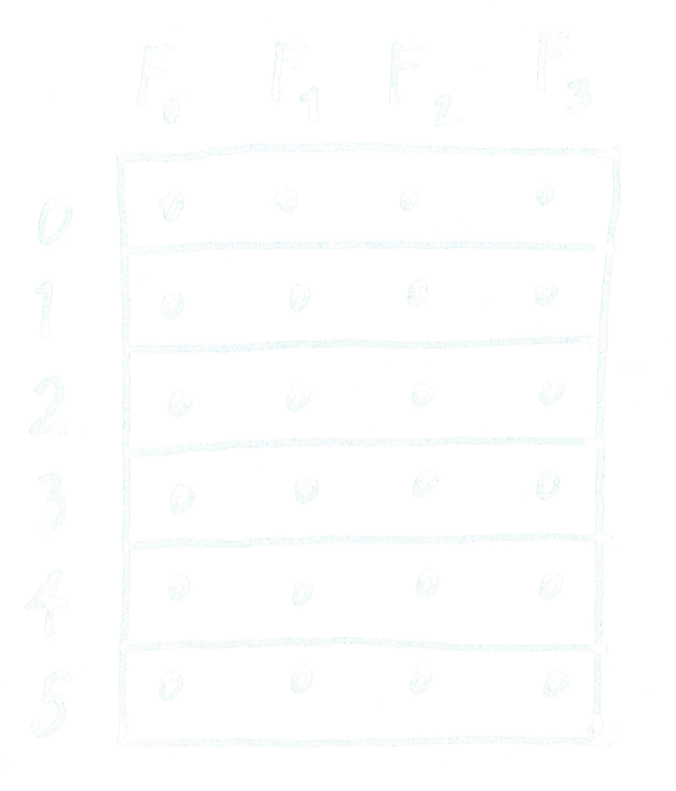
───􀓢───􀓢───􀓢───􀓢───􀓢───􀓥───􀓢───􀓢───􀓢───􀓢───􀓢───􀓢───􀓢───􀓢───􀓢───􀓢──
Inverted Tables
Use inverted tables to represent relations, complex objects.

Slide 30
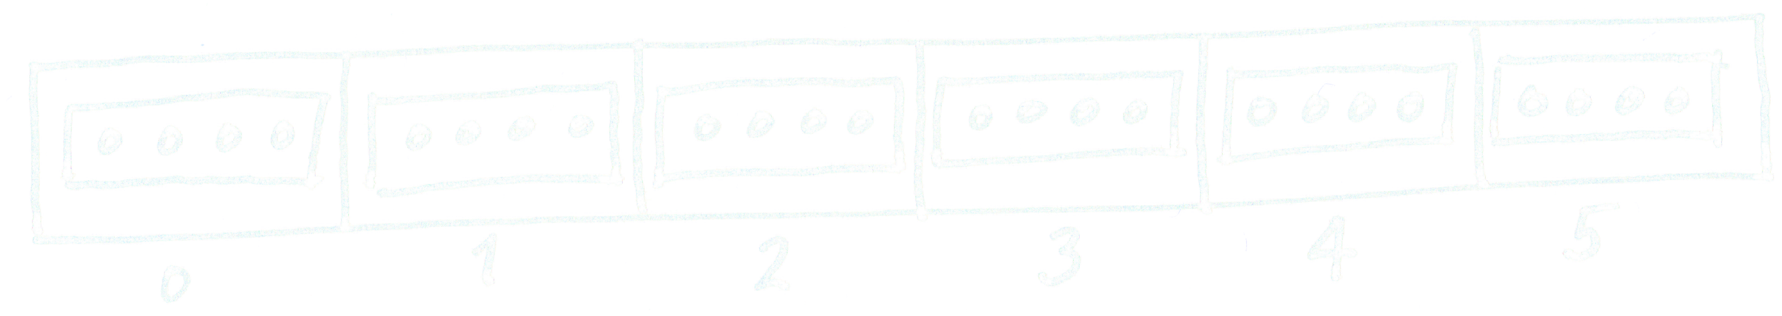
───􀓢───􀓢───􀓢───􀓢───􀓢───􀓥───􀓢───􀓢───􀓢───􀓢───􀓢───􀓢───􀓢───􀓢───􀓢───􀓢──
Inverted Tables
Use inverted tables to represent relations, complex objects.

Slide 31
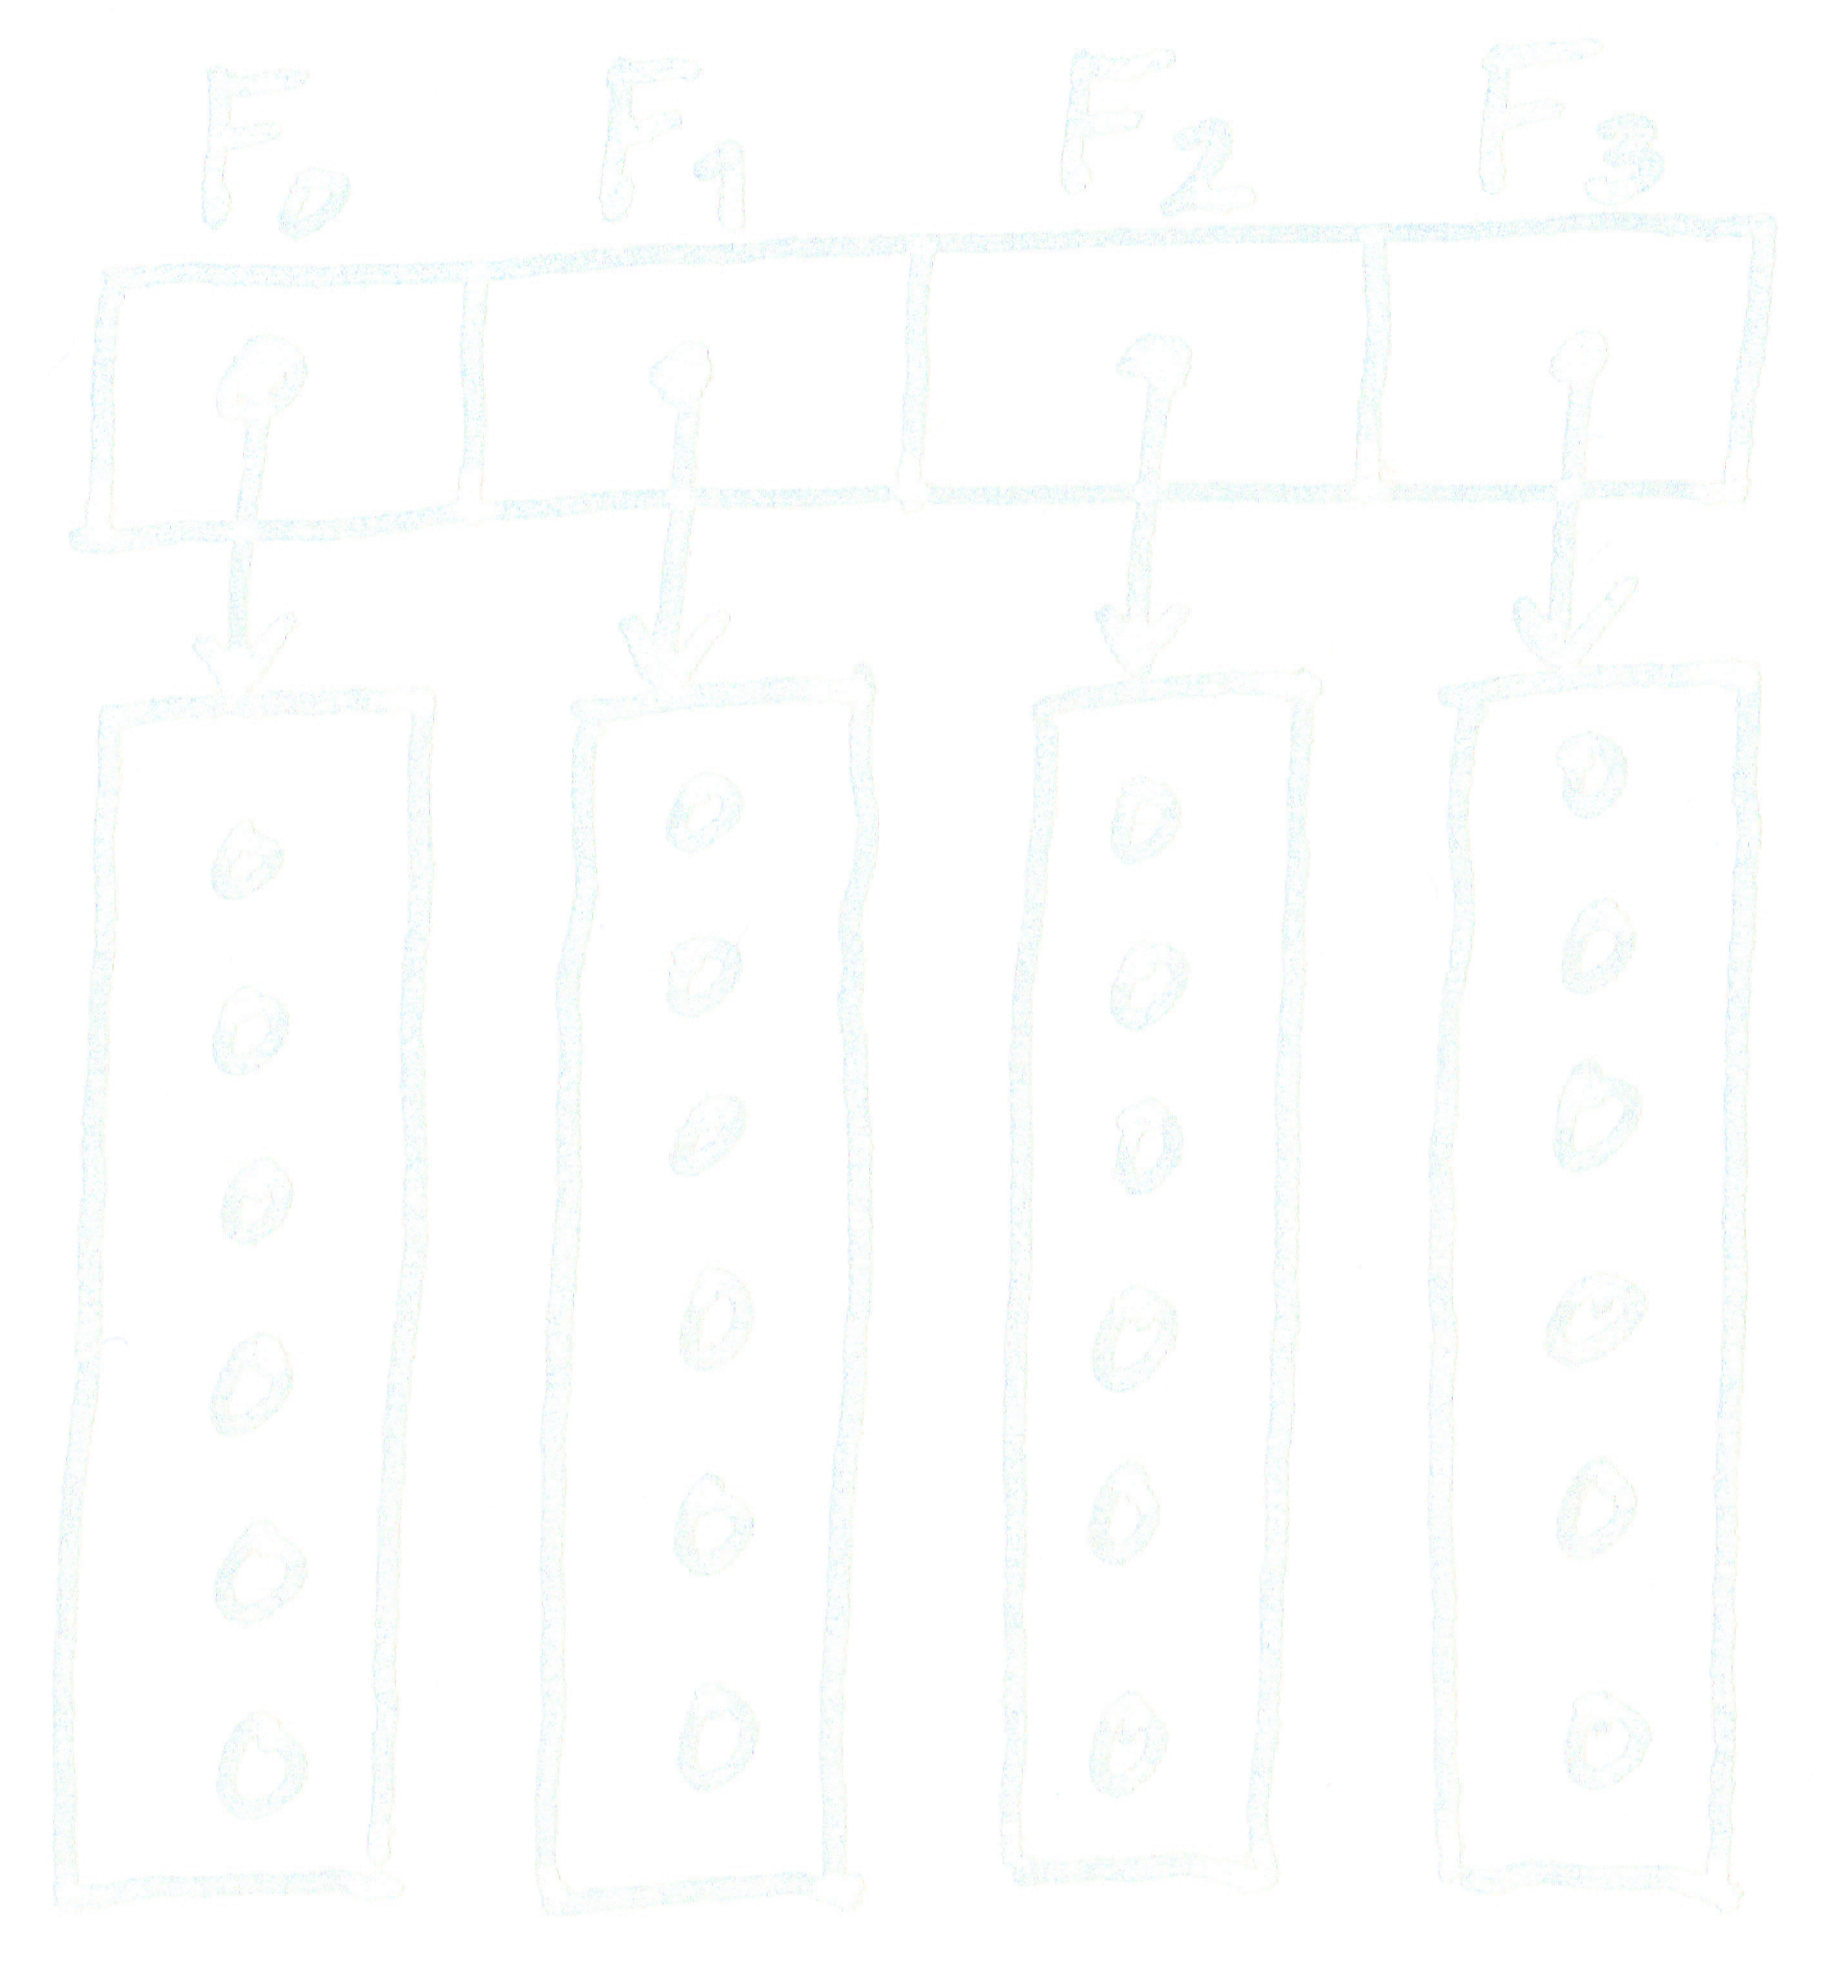
───􀓢───􀓢───􀓢───􀓢───􀓢───􀓥───􀓢───􀓢───􀓢───􀓢───􀓢───􀓢───􀓢───􀓢───􀓢───􀓢──
Inverted Tables
Use inverted tables to represent relations, complex objects.

Slide 32
───􀓢───􀓢───􀓢───􀓢───􀓢───􀓥───􀓢───􀓢───􀓢───􀓢───􀓢───􀓢───􀓢───􀓢───􀓢───􀓢──
Inverted Tables
Use inverted tables to represent relations, complex objects.

Slide 33
───􀓢───􀓢───􀓢───􀓢───􀓢───􀓢───􀓥───􀓢───􀓢───􀓢───􀓢───􀓢───􀓢───􀓢───􀓢───􀓢──
Implicit Structures
Leverage implicit data structures, explicit arrays.

Slide 34
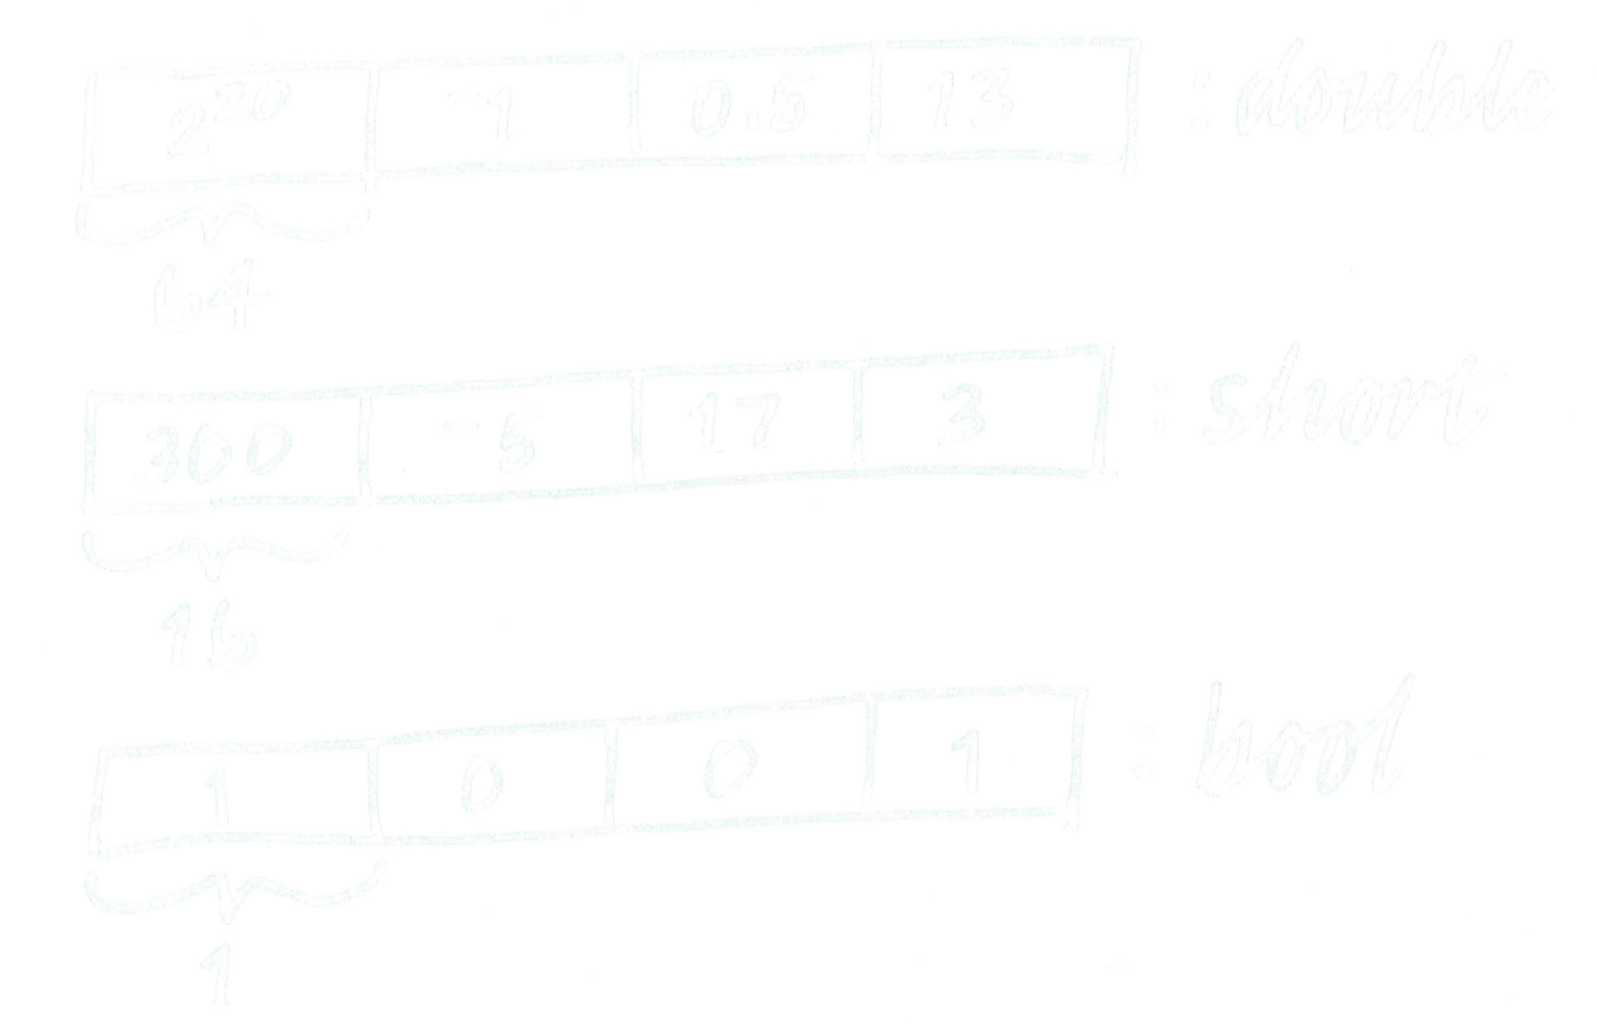
───􀓢───􀓢───􀓢───􀓢───􀓢───􀓢───􀓥───􀓢───􀓢───􀓢───􀓢───􀓢───􀓢───􀓢───􀓢───􀓢──
Implicit Structures
Leverage implicit data structures, explicit arrays.

Slide 35
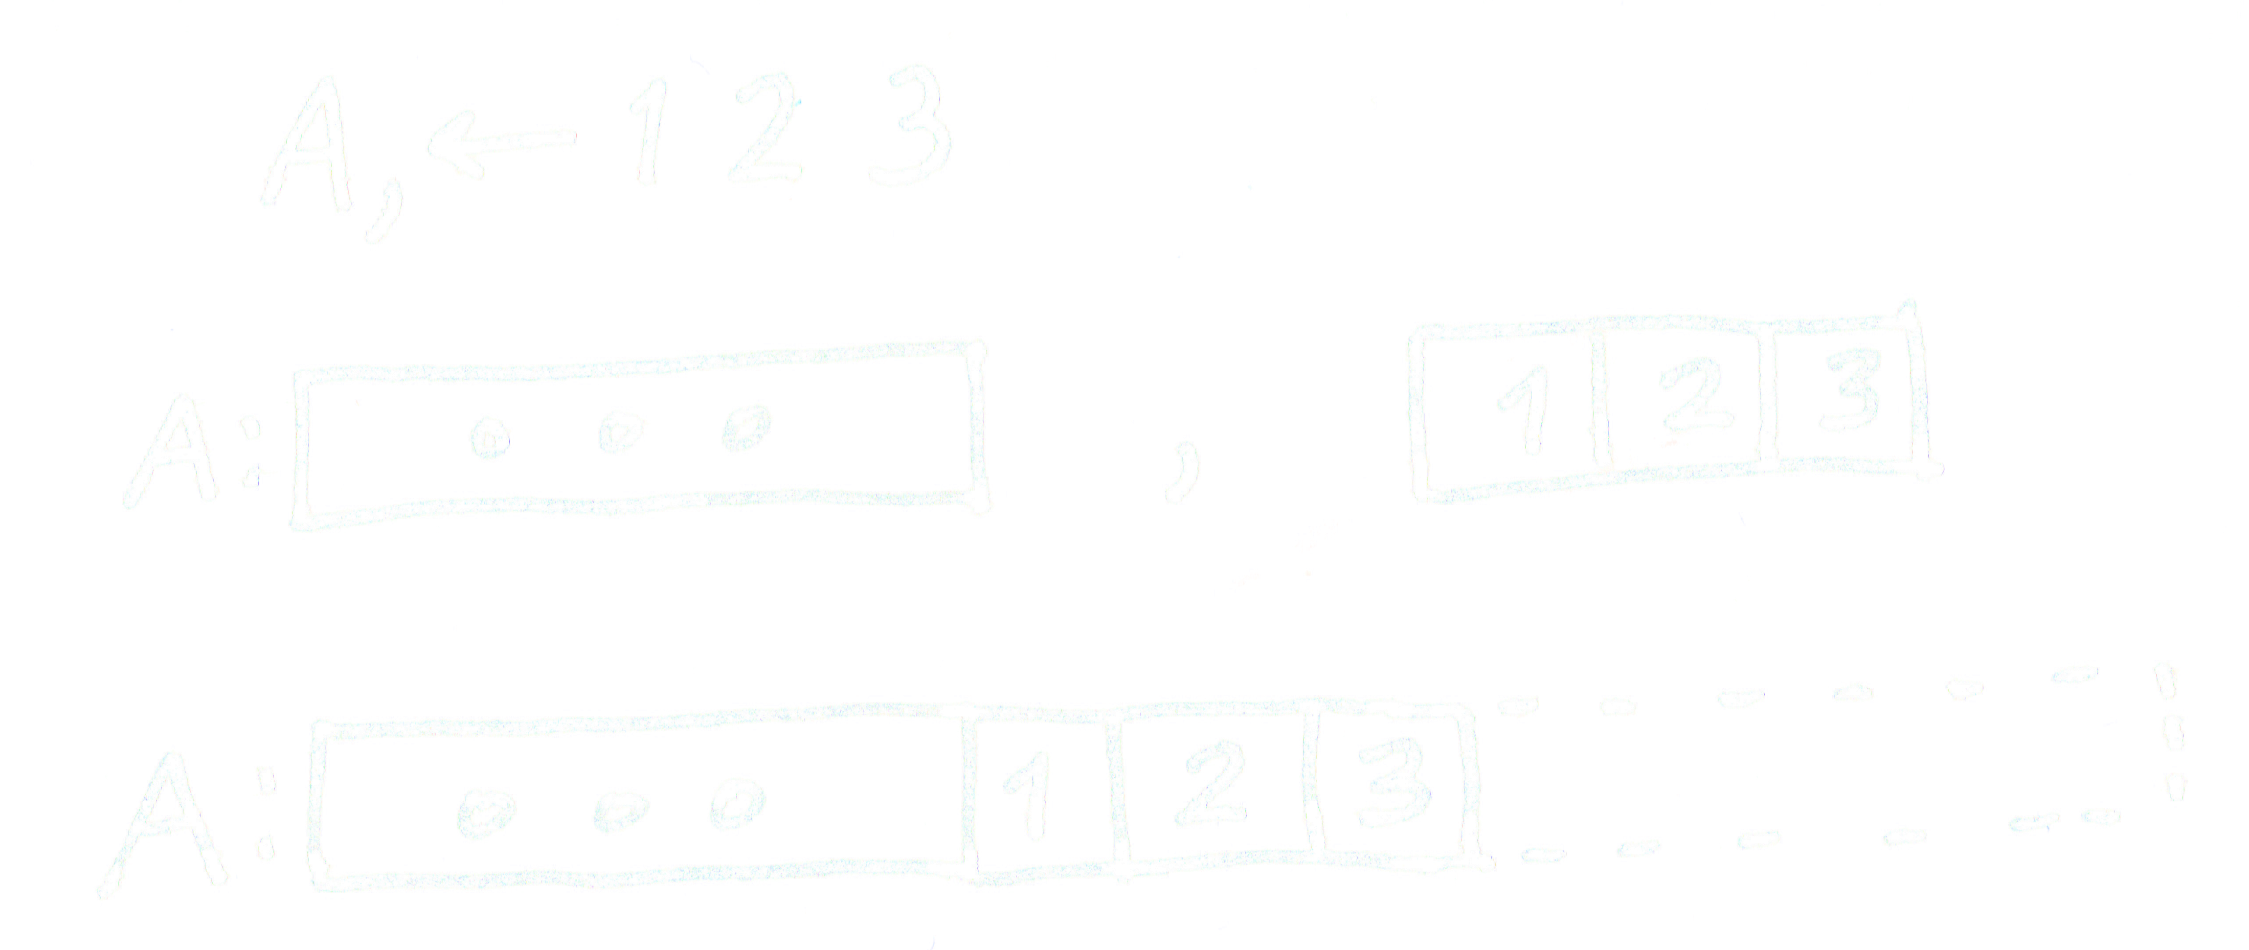
───􀓢───􀓢───􀓢───􀓢───􀓢───􀓢───􀓥───􀓢───􀓢───􀓢───􀓢───􀓢───􀓢───􀓢───􀓢───􀓢──
Implicit Structures
Leverage implicit data structures, explicit arrays.

Slide 36
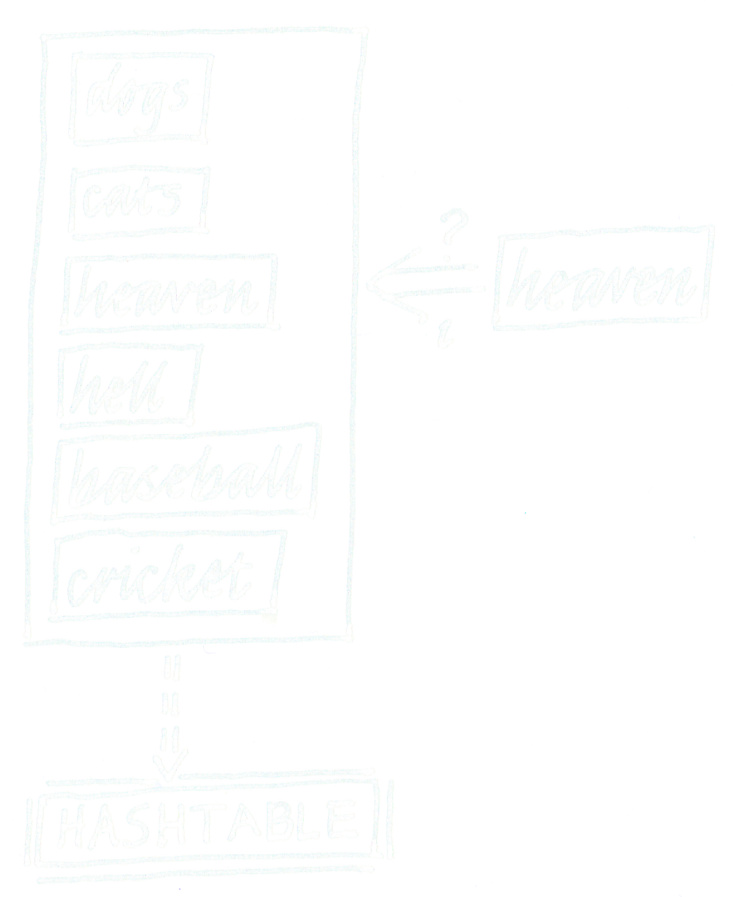
───􀓢───􀓢───􀓢───􀓢───􀓢───􀓢───􀓥───􀓢───􀓢───􀓢───􀓢───􀓢───􀓢───􀓢───􀓢───􀓢──
Implicit Structures
Leverage implicit data structures, explicit arrays.

Slide 37
───􀓢───􀓢───􀓢───􀓢───􀓢───􀓢───􀓢───􀓥───􀓢───􀓢───􀓢───􀓢───􀓢───􀓢───􀓢───􀓢──
Symbol tables
Explicitly intern data using symbol tables.

Slide 38
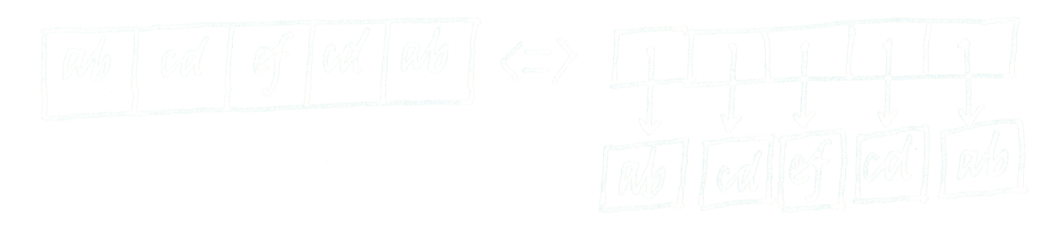

───􀓢───􀓢───􀓢───􀓢───􀓢───􀓢───􀓢───􀓥───􀓢───􀓢───􀓢───􀓢───􀓢───􀓢───􀓢───􀓢──
Symbol tables
Explicitly intern data using symbol tables.

Slide 39
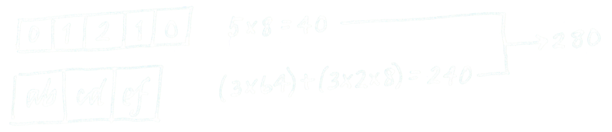

───􀓢───􀓢───􀓢───􀓢───􀓢───􀓢───􀓢───􀓥───􀓢───􀓢───􀓢───􀓢───􀓢───􀓢───􀓢───􀓢──
Symbol tables
Explicitly intern data using symbol tables.

Slide 40
───􀓢───􀓢───􀓢───􀓢───􀓢───􀓢───􀓢───􀓢───􀓥───􀓢───􀓢───􀓢───􀓢───􀓢───􀓢───􀓢──
Pointers
Avoid generalized pointers,
use type-constrained explicit pointers with restricted range.

Slide 41

───􀓢───􀓢───􀓢───􀓢───􀓢───􀓢───􀓢───􀓢───􀓥───􀓢───􀓢───􀓢───􀓢───􀓢───􀓢───􀓢──
Pointers
Avoid generalized pointers,
use type-constrained explicit pointers with restricted range.

Slide 42
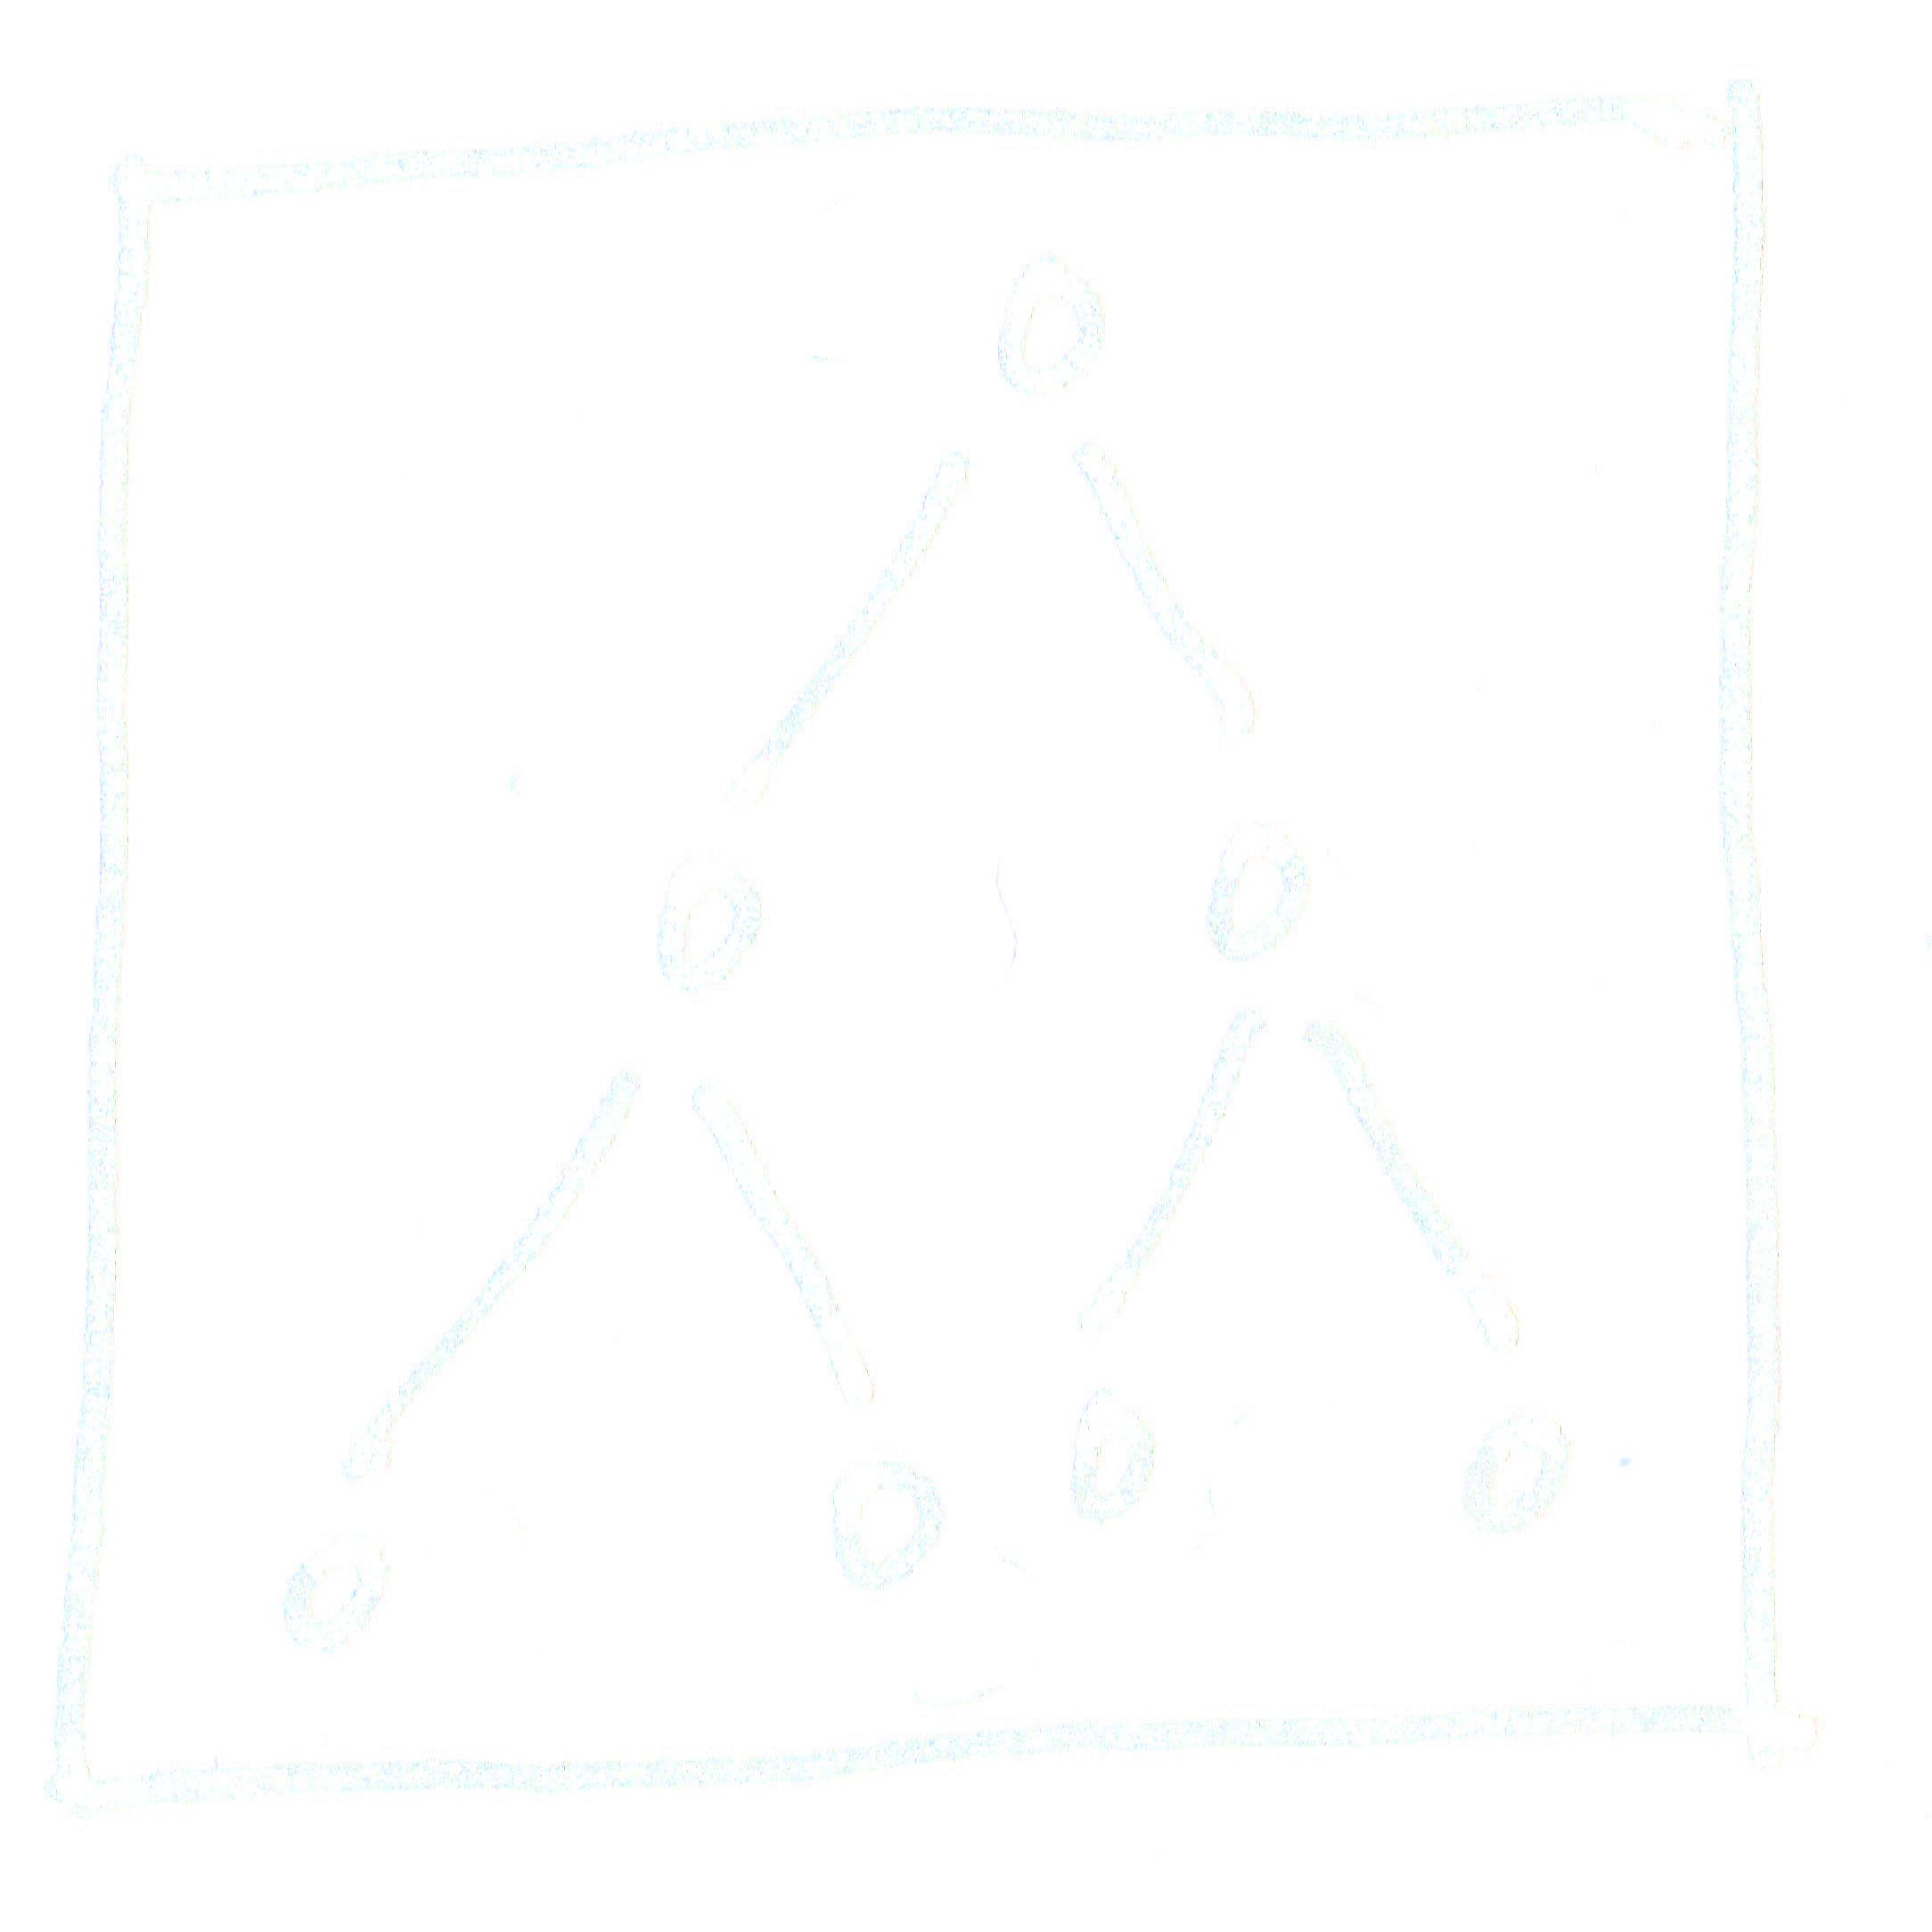
───􀓢───􀓢───􀓢───􀓢───􀓢───􀓢───􀓢───􀓢───􀓥───􀓢───􀓢───􀓢───􀓢───􀓢───􀓢───􀓢──
Pointers
Avoid generalized pointers,
use type-constrained explicit pointers with restricted range.

Slide 43
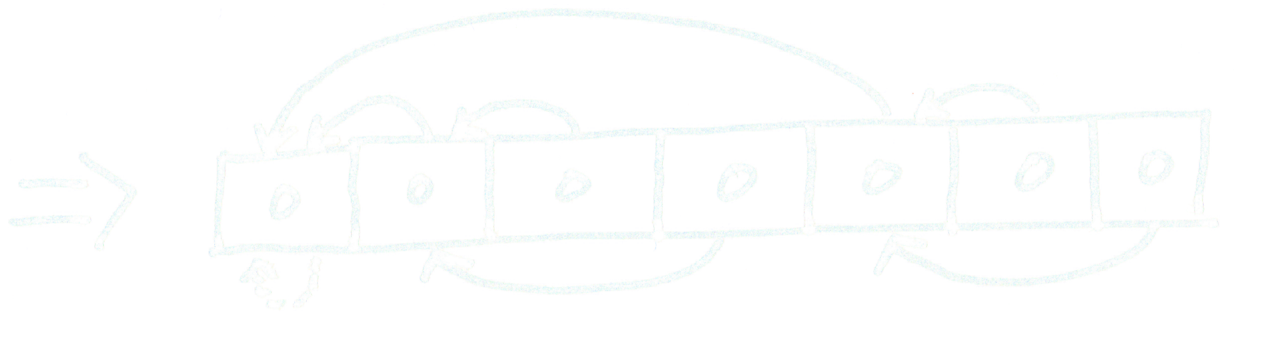
───􀓢───􀓢───􀓢───􀓢───􀓢───􀓢───􀓢───􀓢───􀓥───􀓢───􀓢───􀓢───􀓢───􀓢───􀓢───􀓢──
Pointers
Avoid generalized pointers,
use type-constrained explicit pointers with restricted range.

Slide 44
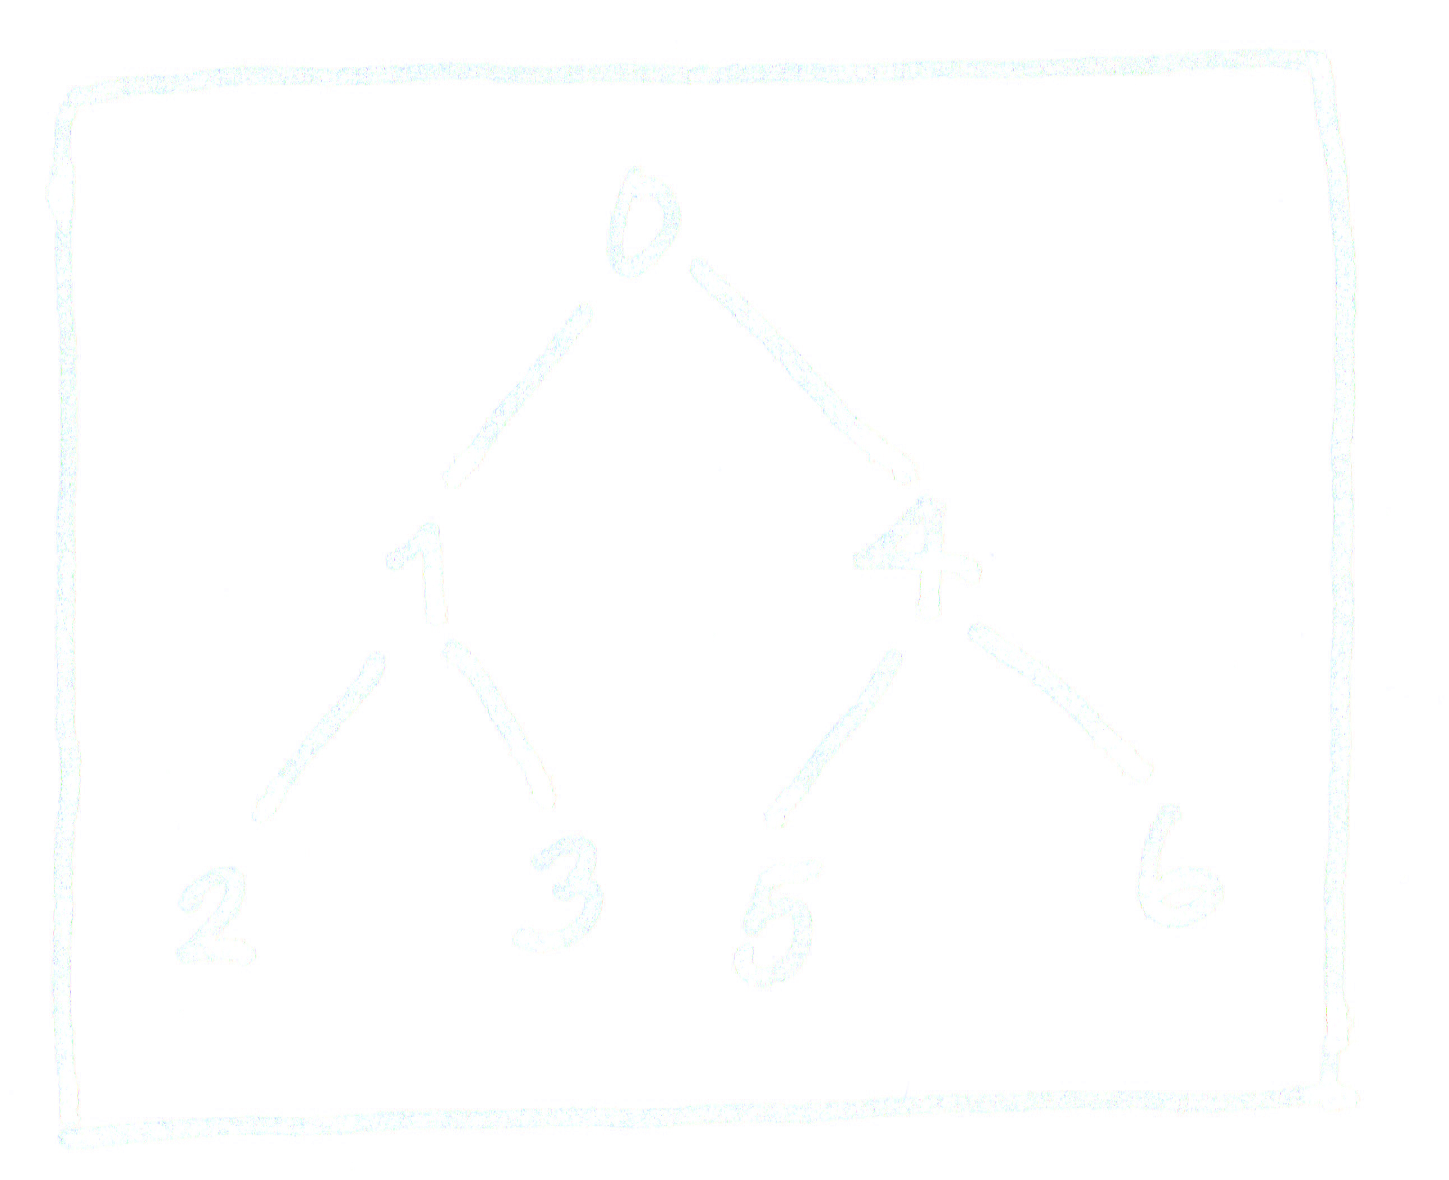

───􀓢───􀓢───􀓢───􀓢───􀓢───􀓢───􀓢───􀓢───􀓥───􀓢───􀓢───􀓢───􀓢───􀓢───􀓢───􀓢──
Pointers
Avoid generalized pointers,
use type-constrained explicit pointers with restricted range.

Slide 45
───􀓢───􀓢───􀓢───􀓢───􀓢───􀓢───􀓢───􀓢───􀓢───􀓥───􀓢───􀓢───􀓢───􀓢───􀓢───􀓢──
Enums/Types
Think aggregately for tags, types, and classes.

Slide 46
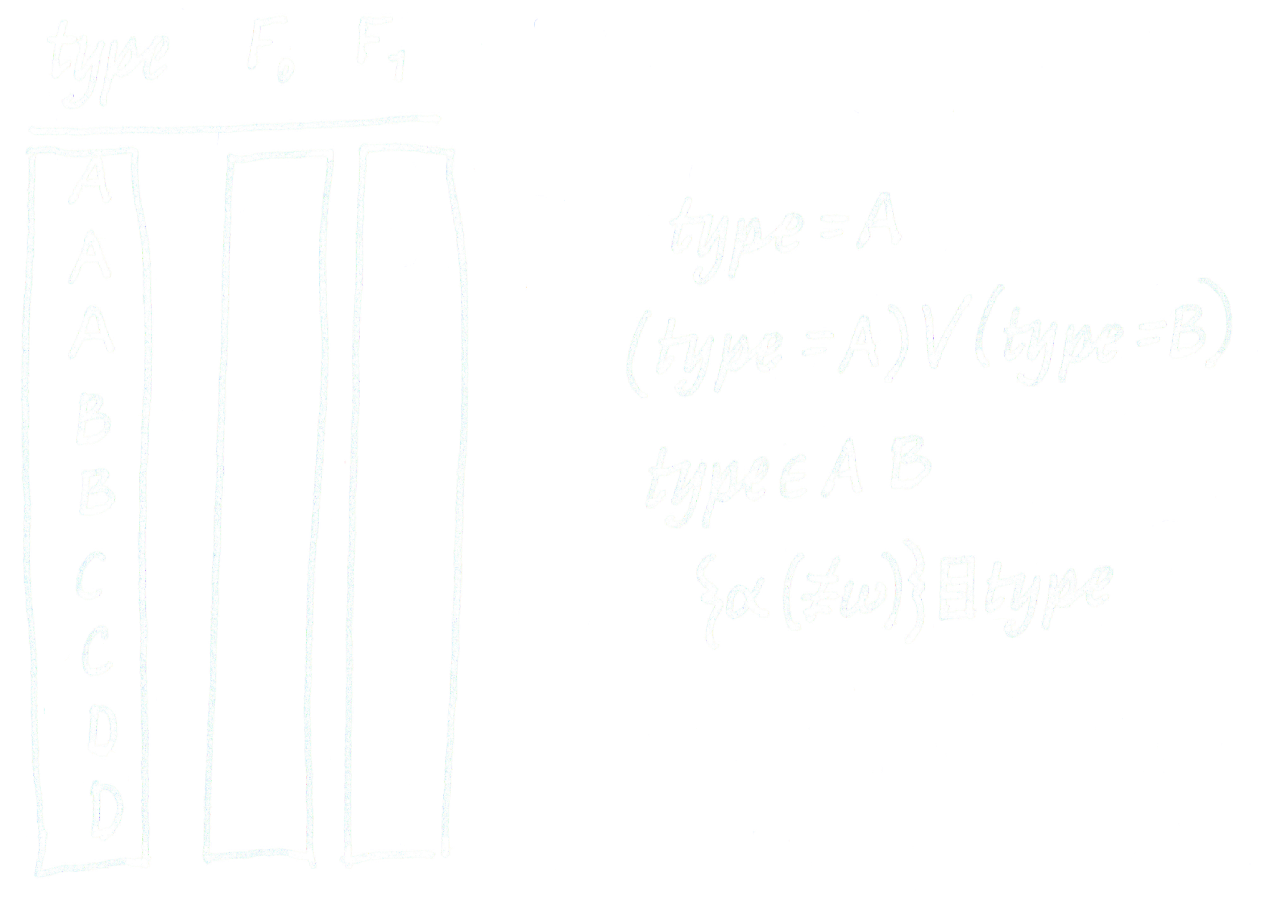
───􀓢───􀓢───􀓢───􀓢───􀓢───􀓢───􀓢───􀓢───􀓢───􀓥───􀓢───􀓢───􀓢───􀓢───􀓢───􀓢──
Enums/Types
Think aggregately for tags, types, and classes.

Slide 47
───􀓢───􀓢───􀓢───􀓢───􀓢───􀓢───􀓢───􀓢───􀓢───􀓢───􀓥───􀓢───􀓢───􀓢───􀓢───􀓢──
Views
You aren’t restricted to a single representation,
don’t be afraid to switch representations to taste.

Slide 48
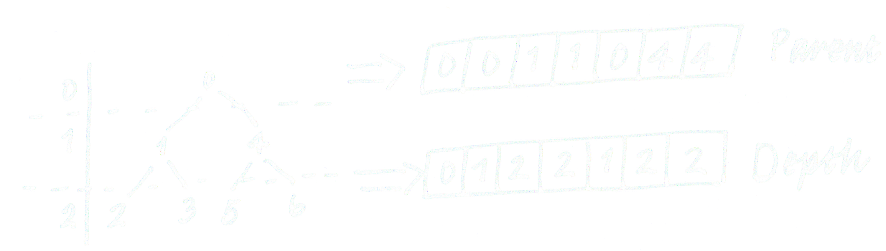
───􀓢───􀓢───􀓢───􀓢───􀓢───􀓢───􀓢───􀓢───􀓢───􀓢───􀓥───􀓢───􀓢───􀓢───􀓢───􀓢──
Views
You aren’t restricted to a single representation,
don’t be afraid to switch representations to taste.

Slide 49
───􀓢───􀓢───􀓢───􀓢───􀓢───􀓢───􀓢───􀓢───􀓢───􀓢───􀓢───􀓥───􀓢───􀓢───􀓢───􀓢──
Boolean Masks
Take advantage of Bitvector masks.

Slide 50

───􀓢───􀓢───􀓢───􀓢───􀓢───􀓢───􀓢───􀓢───􀓢───􀓢───􀓢───􀓥───􀓢───􀓢───􀓢───􀓢──
Boolean Masks
Take advantage of Bitvector masks.

Slide 51
───􀓢───􀓢───􀓢───􀓢───􀓢───􀓢───􀓢───􀓢───􀓢───􀓢───􀓢───􀓥───􀓢───􀓢───􀓢───􀓢──
Boolean Masks
Take advantage of Bitvector masks.
(A×M)+(B×~M) ⍝ Select A if M, B otherwise
M⍀f(M⌿A) ⍝ Masked A modified by f

Slide 52
───􀓢───􀓢───􀓢───􀓢───􀓢───􀓢───􀓢───􀓢───􀓢───􀓢───􀓢───􀓢───􀓥───􀓢───􀓢───􀓢──
Keys
Combine Enums, Views, and Masks
by using “Keys” either explicitly or implicitly.

Slide 53

───􀓢───􀓢───􀓢───􀓢───􀓢───􀓢───􀓢───􀓢───􀓢───􀓢───􀓢───􀓢───􀓥───􀓢───􀓢───􀓢──
Keys
Combine Enums, Views, and Masks
by using “Keys” either explicitly or implicitly.
xoFnworBkciuQehT
4443333322222111
ehTkciuQnworBxoF
1112222233333444
ehT kciuQ nworB xoF
1110111110111110111

Slide 54
───􀓢───􀓢───􀓢───􀓢───􀓢───􀓢───􀓢───􀓢───􀓢───􀓢───􀓢───􀓢───􀓥───􀓢───􀓢───􀓢──
TAO
Embrace the Total Array Ordering:
Leverage permutations and total array ordering
for knowledge embedding.

Slide 55
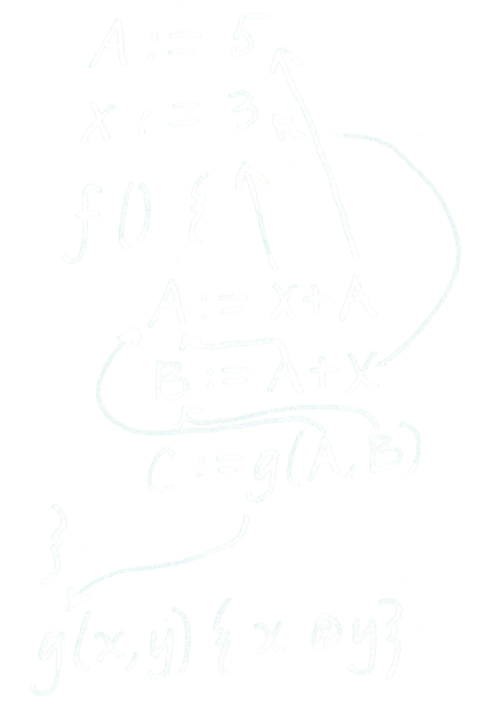
───􀓢───􀓢───􀓢───􀓢───􀓢───􀓢───􀓢───􀓢───􀓢───􀓢───􀓢───􀓢───􀓥───􀓢───􀓢───􀓢──
TAO
Embrace the TAO:

Slide 56

───􀓢───􀓢───􀓢───􀓢───􀓢───􀓢───􀓢───􀓢───􀓢───􀓢───􀓢───􀓢───􀓥───􀓢───􀓢───􀓢──
TAO
Embrace the TAO:

Slide 57
───􀓢───􀓢───􀓢───􀓢───􀓢───􀓢───􀓢───􀓢───􀓢───􀓢───􀓢───􀓢───􀓢───􀓥───􀓢───􀓢──
Rel. Work
Related Work
Moseley, Ben, and Peter Marks. "Out of the tar pit."
Software Practice Advancement (SPA) 2006 (2006).
https://blog.royalsloth.eu/archive/outOfTheTarPit.pdf

Slide 58
───􀓢───􀓢───􀓢───􀓢───􀓢───􀓢───􀓢───􀓢───􀓢───􀓢───􀓢───􀓢───􀓢───􀓢───􀓥───􀓢──
Lessons

Slide 59
───􀓢───􀓢───􀓢───􀓢───􀓢───􀓢───􀓢───􀓢───􀓢───􀓢───􀓢───􀓢───􀓢───􀓢───􀓥───􀓢──
Lessons
Data hiding is a myth, so embrace more control.

Slide 60
───􀓢───􀓢───􀓢───􀓢───􀓢───􀓢───􀓢───􀓢───􀓢───􀓢───􀓢───􀓢───􀓢───􀓢───􀓥───􀓢──
Lessons
Data hiding is a myth, so embrace more control.
Data encoding is critical to efficient array programming.

Slide 61
───􀓢───􀓢───􀓢───􀓢───􀓢───􀓢───􀓢───􀓢───􀓢───􀓢───􀓢───􀓢───􀓢───􀓢───􀓥───􀓢──
Lessons
Data hiding is a myth, so embrace more control.
Data encoding is critical to efficient array programming.
You can regain control over your data without losing convenience.

Slide 62
───􀓢───􀓢───􀓢───􀓢───􀓢───􀓢───􀓢───􀓢───􀓢───􀓢───􀓢───􀓢───􀓢───􀓢───􀓥───􀓢──
Lessons
Data hiding is a myth, so embrace more control.
Data encoding is critical to efficient array programming.
You can regain control over your data without losing convenience.
Data-driven code should fall out naturally.

Slide 63
───􀓢───􀓢───􀓢───􀓢───􀓢───􀓢───􀓢───􀓢───􀓢───􀓢───􀓢───􀓢───􀓢───􀓢───􀓥───􀓢──
Lessons
Data hiding is a myth, so embrace more control.
Data encoding is critical to efficient array programming.
You can regain control over your data without losing convenience.
Data-driven code should fall out naturally.
Utilize implicit data structures under an array model.

Slide 64
───􀓢───􀓢───􀓢───􀓢───􀓢───􀓢───􀓢───􀓢───􀓢───􀓢───􀓢───􀓢───􀓢───􀓢───􀓥───􀓢──
Lessons
Data hiding is a myth, so embrace more control.
Data encoding is critical to efficient array programming.
You can regain control over your data without losing convenience.
Data-driven code should fall out naturally.
Utilize implicit data structures under an array model.
Use low-level thinking with high-level language conveniences.

Slide 65
───􀓢───􀓢───􀓢───􀓢───􀓢───􀓢───􀓢───􀓢───􀓢───􀓢───􀓢───􀓢───􀓢───􀓢───􀓥───􀓢──
Lessons
Data hiding is a myth, so embrace more control.
Data encoding is critical to efficient array programming.
You can regain control over your data without losing convenience.
Data-driven code should fall out naturally.
Utilize implicit data structures under an array model.
Use low-level thinking with high-level language conveniences.
Stick to global, avoid long-lived intermediate state.

Slide 66
───􀓢───􀓢───􀓢───􀓢───􀓢───􀓢───􀓢───􀓢───􀓢───􀓢───􀓢───􀓢───􀓢───􀓢───􀓥───􀓢──
Lessons
Data hiding is a myth, so embrace more control.
Data encoding is critical to efficient array programming.
You can regain control over your data without losing convenience.
Data-driven code should fall out naturally.
Utilize implicit data structures under an array model.
Use low-level thinking with high-level language conveniences.
Stick to global, avoid long-lived intermediate state.
Take advantage of functional principles to manage global state.

Slide 67
───􀓢───􀓢───􀓢───􀓢───􀓢───􀓢───􀓢───􀓢───􀓢───􀓢───􀓢───􀓢───􀓢───􀓢───􀓢───􀓥──
Conclusion
Thank you. Questions?
aaron@dyalog.com
Data hiding is a myth, so embrace more control.
Data encoding is critical to efficient array programming.
You can regain control over your data without losing convenience.
Data-driven code should fall out naturally.
Utilize implicit data structures under an array model.
Use low-level thinking with high-level language conveniences.
Stick to global, avoid long-lived intermediate state.
Take advantage of functional principles to manage global state.

